Slide 1


Slide 2
Chapter 11 Outline
A Simple PHP Example
Overview of Basic Features of PHP
Overview of PHP Database Programming
Slide 11- 2

Slide 3
Web Database
Programming Using PHP
Techniques for programming dynamic features into Web
PHP
  Open source scripting language
  Interpreters provided free of charge
  Available on most computer platforms
Slide 11- 3

Slide 4
A Simple PHP Example
PHP
  Open source general-purpose scripting language
  Comes installed with the UNIX operating system
Slide 11- 4

Slide 5
A Simple PHP Example (cont’d.)
DBMS
  Bottom-tier database server
PHP
  Middle-tier Web server
HTML
  Client tier
Slide 11- 5

Slide 6
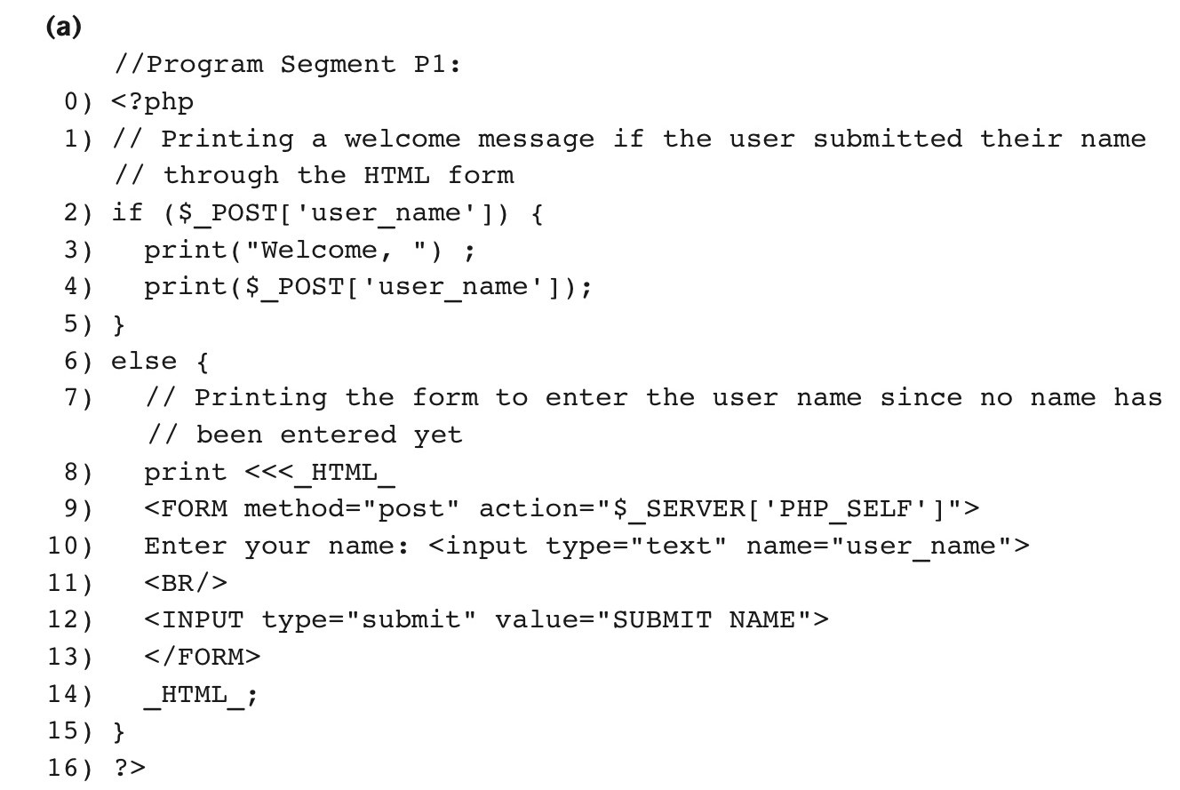
Figure 11.1a PHP program segment for entering a greeting.
continued on next slide
Slide 11- 6

Slide 7
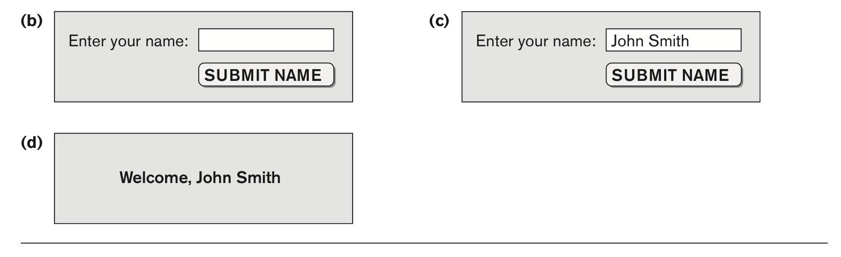
Figure 11.1b-d (b) Initial form displayed by PHP program segment. (c) User enters name John Smith. (d) Form prints welcome message for John Smith.
Slide 11- 7

Slide 8
A Simple PHP Example (cont’d.)
Example Figure 11.1(a)
PHP script stored in:
  http://www.myserver.com/example/greeting.php
<?php
  PHP start tag
?>
  PHP end tag
Comments: // or /* */
Slide 11- 8

Slide 9
A Simple PHP Example (cont’d.)
$_POST
  Auto-global predefined PHP variable
  Array that holds all the values entered through form parameters
Arrays are dynamic
Long text strings
  Between opening <<<_HTML_ and closing _HTML_;
Slide 11- 9

Slide 10
A Simple PHP Example (cont’d.)
PHP variable names
  Start with $ sign
Slide 11- 10

Slide 11
Overview of Basic Features of PHP
Illustrate features of PHP suited for creating dynamic Web pages that contain database access commands
Slide 11- 11

Slide 12
PHP Variables, Data Types, and Programming Constructs
PHP variable names
  Start with $ symbol
  Can include characters, letters, and underscore character (_)
Main ways to express strings and text
  Single-quoted strings
  Double-quoted strings
  Here documents
  Single and double quotes
Slide 11- 12

Slide 13
PHP Variables, Data Types, and Programming Constructs (cont’d.)
  Period (.) symbol
  String concatenate operator
Single-quoted strings
  Literal strings that contain no PHP program variables
Double-quoted strings and here documents
  Values from variables need to be interpolated into string
Slide 11- 13

Slide 14
PHP Variables, Data Types, and Programming Constructs (cont’d.)
Numeric data types
  Integers and floating points
Programming language constructs
  For-loops, while-loops, and conditional if-statements
Boolean expressions
Slide 11- 14

Slide 15
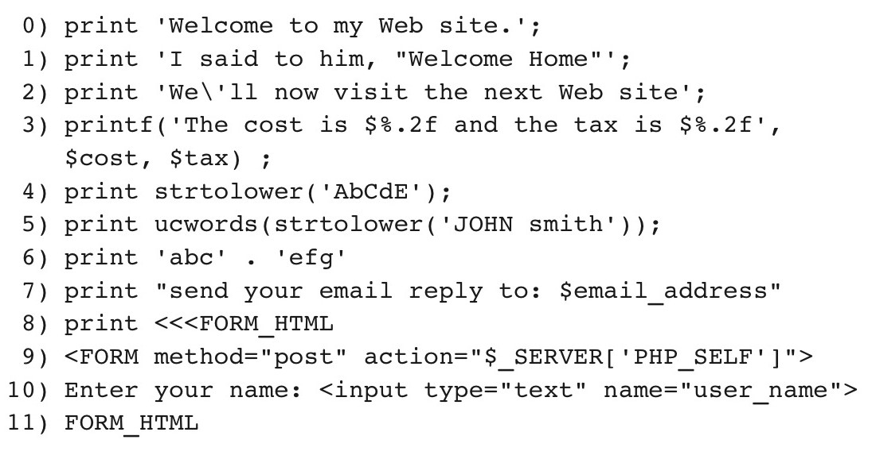
Figure 11.2 Illustrating basic PHP string and text values.
Slide 11- 15

Slide 16
PHP Variables, Data Types, and Programming Constructs (cont’d.)
Comparison operators
  == (equal), != (not equal), > (greater than), >= (greater than or equal), < (less than), and <= (less than or equal)
Slide 11- 16

Slide 17
PHP Arrays
Can hold database query results
  Two-dimensional arrays
  First dimension representing rows of a table
  Second dimension representing columns (attributes) within a row
Main types of arrays:
  Numeric and associative
Slide 11- 17

Slide 18
PHP Arrays (cont’d.)
Numeric array
  Associates a numeric index with each element in the array
  Indexes are integer numbers
    Start at zero
    Grow incrementally
Associative array
  Provides pairs of (key => value) elements
Slide 11- 18

Slide 19
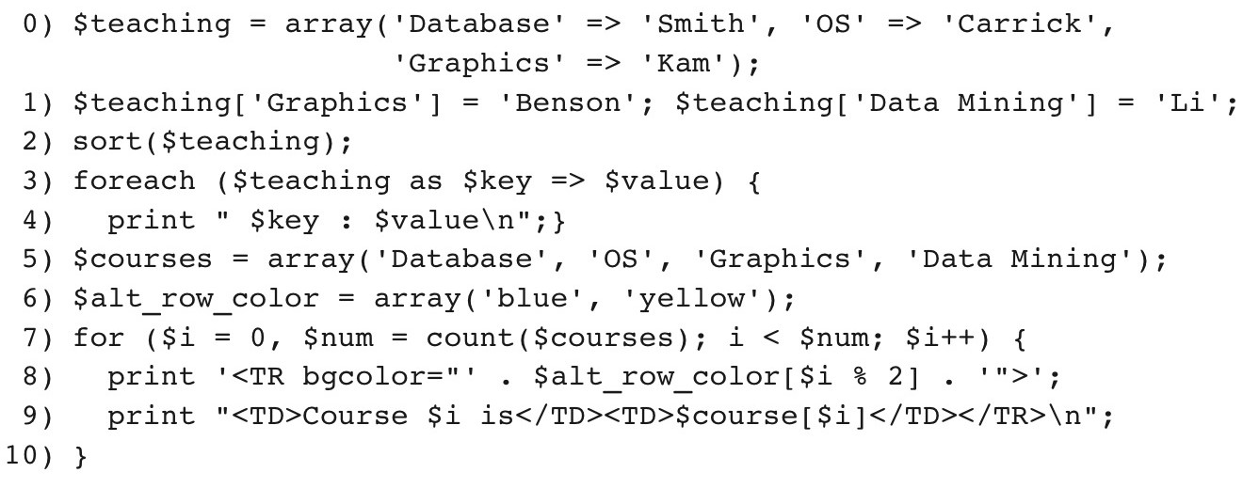
Figure 11.3 Illustrating basic PHP array processing.
Slide 11- 19

Slide 20
PHP Arrays (cont’d.)
Techniques for looping through arrays in PHP
Count function
  Returns current number of elements in array
Sort function
  Sorts array based on element values in it
Slide 11- 20

Slide 21
PHP Functions
Functions
  Define to structure a complex program and to share common sections of code
  Arguments passed by value
Examples to illustrate basic PHP functions
  Figure 11.4
  Figure 11.5
Slide 11- 21

Slide 22
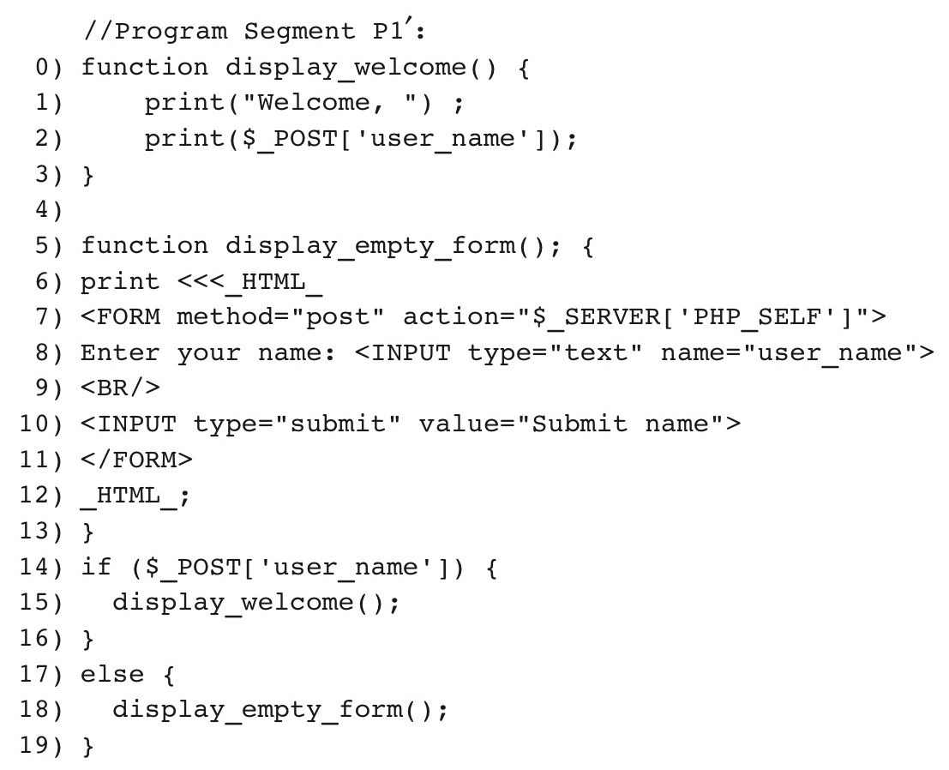
Figure 11.4 Rewriting program segment P1 as P1′ using functions.
Slide 11- 22

Slide 23
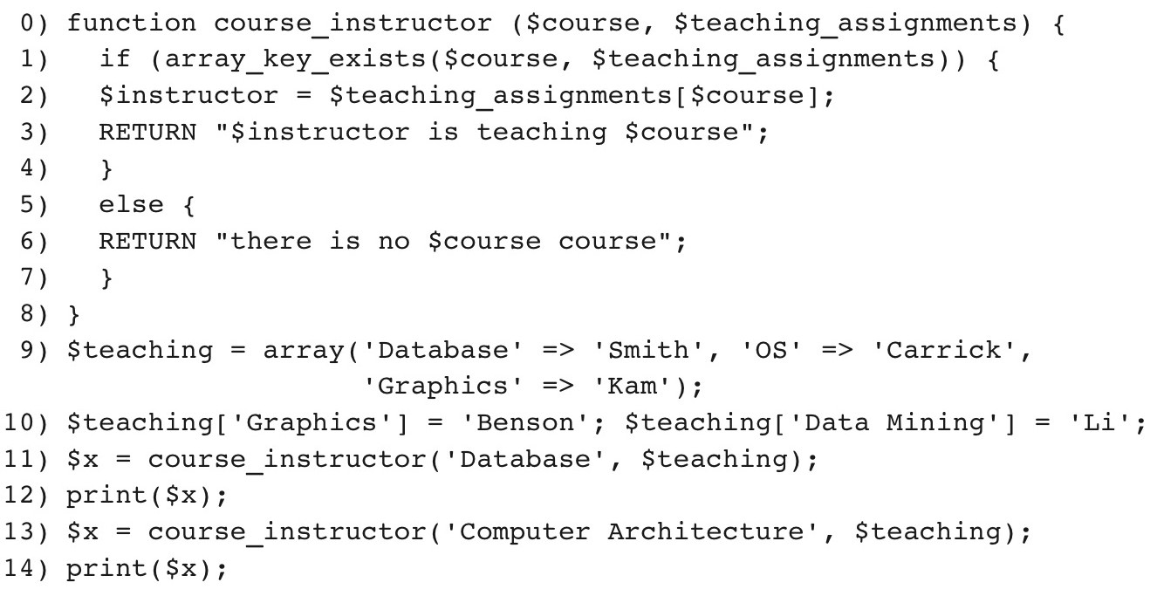
Figure 11.5 Illustrating a function with arguments and return value.
Slide 11- 23

Slide 24
PHP Server Variables and Forms
Built-in entries
  $_SERVER auto-global built-in array variable
  Provides useful information about server where the PHP interpreter is running
Slide 11- 24

Slide 25
PHP Server Variables and Forms (cont’d.)
  Examples:
    $_SERVER['SERVER_NAME']
    $_SERVER['REMOTE_ADDRESS']
    $_SERVER['REMOTE_HOST']
    $_SERVER['PATH_INFO']
    $_SERVER['QUERY_STRING']
    $_SERVER['DOCUMENT_ROOT']
$_POST
  Provides input values submitted by the user through HTML forms specified in <INPUT> tag
Slide 11- 25

Slide 26
Overview of PHP Database Programming
PEAR DB library
  Part of PHP Extension and Application Repository (PEAR)
  Provides functions for database access
Slide 11- 26

Slide 27
Connecting to a Database
Library module DB.php must be loaded
DB library functions accessed using DB::<function_name>
DB::connect('string')
  Function for connecting to a database
  Format for 'string' is: <DBMS software>://<user account>:<password>@<database server>
Slide 11- 27

Slide 28
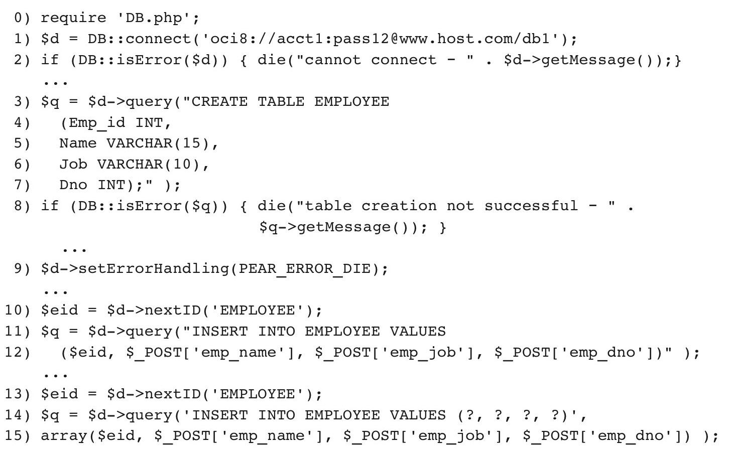
Figure 11.6 Connecting to a database, creating a table, and inserting a record.
Slide 11- 28

Slide 29
Some Database Functions
Query function
  $d->query takes an SQL command as its string argument
  Sends query to database server for execution
$d–>setErrorHandling(PEAR_ERROR_DIE)
  Terminate program and print default error messages if any subsequent errors occur
Slide 11- 29

Slide 30
Collecting Data from Forms and Inserting Records
Collect information through HTML or other types of Web forms
Create unique record identifier for each new record inserted into the database
PHP has a function $d–>nextID to create a sequence of unique values for a particular table
Placeholders
  Specified by ? symbol
Slide 11- 30

Slide 31
Retrieval Queries from Database Tables
$q
  Variable that holds query result
  $q->fetchRow() retrieve next record in query result and control loop
$allresult = $d->getAll(query)
  Holds all the records in a query result in a single variable called $allresult
Slide 11- 31

Slide 32
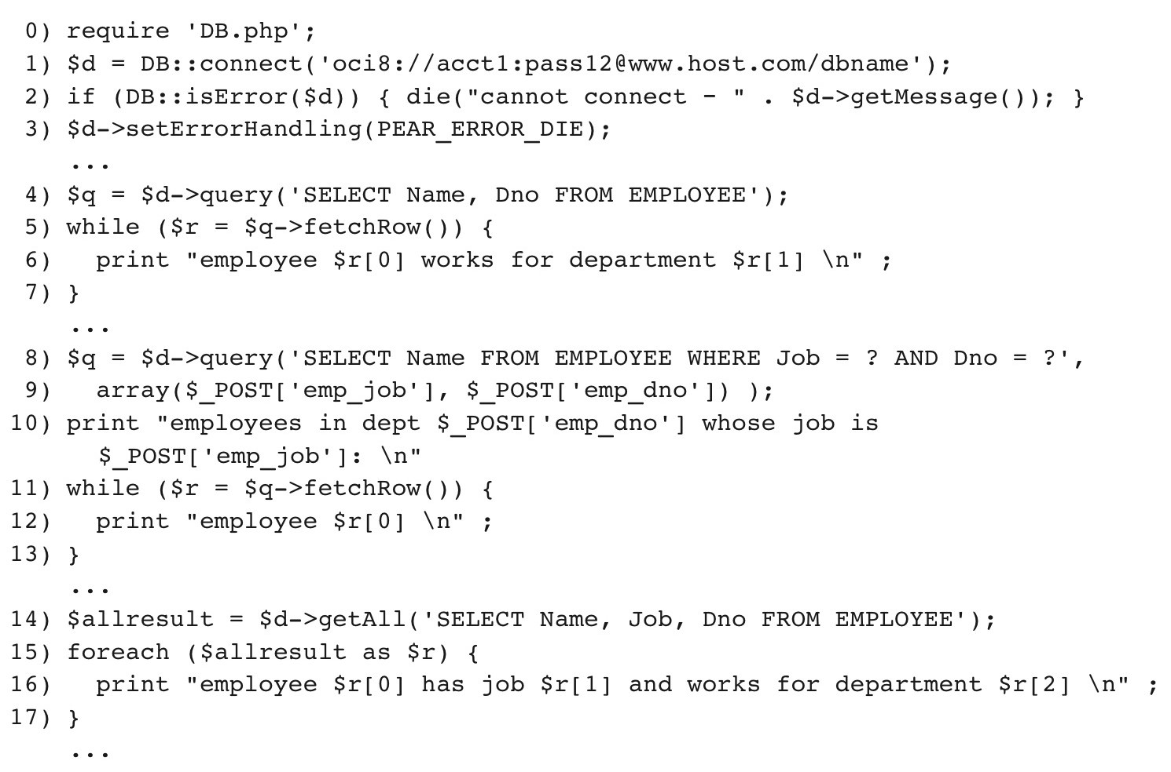
Figure 11.7 Illustrating database retrieval queries.
Slide 11- 32

Slide 33
Other techniques
PHP runs on server
  Sends HTML to client
Many other languages/technologies for Web Db programming
Examples:
Java servlets:
  Java objects on server, interact with client
  Store information about interaction session
Slide 11- 33

Slide 34
Other techniques (cont.)
Java Server Pages (JSP)
  Creates dynamic Web pages through scripting at server to send to client (somewhat like PHP)
JavaScript
  Scripting language, can run at client or server
Java Script Object Notation (JSON):
  Text-based representation of objects
  Similar function to XML
  Used in many NOSQL systems
Slide 11- 34

Slide 35
Summary
PHP scripting language
  Very popular for Web database programming
PHP basics for Web programming
Data types
Database commands include:
  Creating tables, inserting new records, and retrieving database records
  Looping over a query result
Slide 11- 35

